Slide 1
Linear Regression

Slide 2
Linear Regression
A Production House in Mumbai wants to analyse the relationship between the promotion and sales for their daily serials. They want to know how much revenue would be generated if they spend Rs.4,00,000 on promotion of a new serial.
In the Data set 1, we can see that the data is linearly
distributed.
Data set 1
Serial | Promotion | Revenue
1 | 1,00,000 | 11,00,000
2 | 1,50,000 | 16,00,000
3 | 2,00,000 | 21,00,000
4 | 2,40,000 | 25,00,000
5 | 3,00,000 | 31,00,000
Revenue
4,000,000
3,000,000
2,000,000
1,000,000
0
0
100,000
200,000
300,000
400,000

Slide 3
Linear Regression
For every 1 additional unit on promotional expenses, the revenue figure is increasing by 10. i.e. when the promotional expenses increased by 50,000, in serial no. 2, their revenue also increased by 5,00,000.
In all the serials, you can also notice that revenue is 10 * Promotion + 1,00,000 i.e. 1,00,000*10 + 1,00,000 = 11,00,000 for serial 1 and 1,50,000*10 + 1,00,000 = 16,00,000 and so on. Therefore, you also have to add Rs.100,000 to every serial.
Therefore, if the promotion house spend Rs.4,00,000, then
the revenue will be : 4,00,000 * 10 + 1,00,000 = 41,00,000
This example is one of the simplest form of Regression
Data set 1
Serial | Promotion | Revenue = 10*Promotion + 100000
Serial 1 | 1,00,000 | 1100000
Serial 2 | 1,50,000 | 1600000
Serial 3 | 2,00,000 | 2100000
Serial 4 | 2,40,000 | 2500000
Serial 5 | 3,00,000 | 3100000
Revenue
4,000,000
3,000,000
2,000,000
1,000,000
0
0
100,000
200,000
300,000
400,000

Slide 4
Linear Regression
If you get a complex data set ( Ref. Data 1 ) it’s difficult to find out the relationship between the promotion and revenue just by observation.
To know the relationship between the variables and predict
the revenue , we need to understand regression in details.
Data Set 2
Serial | Promotion | Revenue
1 | 111600 | 1197576
2 | 104400 | 1053648
3 | 97200 | 1124172
4 | 79200 | 987144
5 | 126000 | 1283616
6 | 108000 | 1295100
7 | 147600 | 1407444
8 | 104400 | 922416
9 | 169200 | 1272012
10 | 75600 | 1064856
11 | 133200 | 1269960
12 | 133200 | 1064760
13 | 176400 | 1207488
14 | 180000 | 1186284
15 | 133200 | 1231464
16 | 147600 | 1296708
17 | 122400 | 1320648
18 | 158400 | 1102704
19 | 165600 | 1184316
20 | 104400 | 1326360

Slide 5
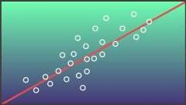
What is Linear Regression?
A statistical measure that attempts to determine the strengths of the relationship between one dependent variable(usually denoted by Y) and a series of the other changing variable (Known as independent variable)
In another word: Regression is an mathematical technique used
to estimate the cause and effect relationship among variables

Slide 6
Regression?
For example: what happens to the revenue coming from advertisement of a Television program, if the production house decide to increase the promotional budget by Rs.1,00,000
Here:
Cause : Money spend on Promotion
Effect : An increase in Advertisement Revenue
We know that the effect of an increase in money spent in Promotion is an increase in Advertisement
Revenue - If we also want to know by how much?
The regression technique tells us what is the impact and what is the quantification of the impact when
we have cause and effect relationship

Slide 7





Applications of Linear Regression
Which consumer is
likely to default?
Which promotion is
more effective?
What is the risk associated
with a consumer?
What percentage of loans
is likely to result in a loss?
How to identify the most
profitable customer?

Slide 8
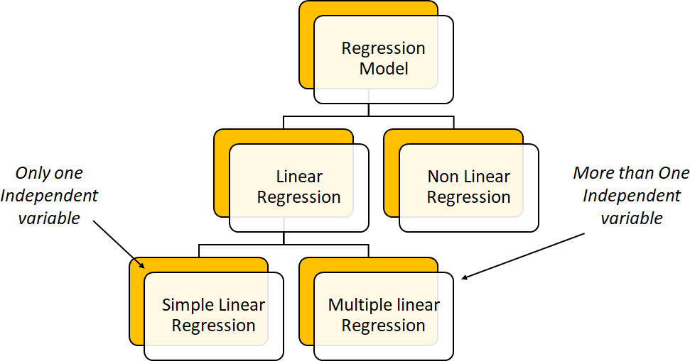
Types of Linear Regression

Slide 9
Regression Analysis Forms and Types
Simple Linear Regression: Single explanatory variable
Only one independent variable, X
In our Case: X = Promotion
Y = Advertisement Revenue
Relationship between X and Y is described by a linear function
Changes in Y are assumed to be related to changes in X
Equation: Y = a + bX
Multiple Linear Regression: Includes any number of explanatory variables
Two or more independent variables, X’s
In our Case: X = Television Rating Points, Language of the program (Hindi or regional language),
Money spent on Promotion.
Relationship between X’s and Y is described by a linear function
Changes in Y are assumed to be related to changes in X
Equation: Y = a + b₁*X₁ + b₂*X₂ + ... + b_{p}*X_{p}
Non-linear: Implies curved relationships
Logarithmic Relationships

Slide 10
Terminology
Dependent variable: The variable we wish to predict or explain. It can also be called Measured variable or Explained variable or Response variable.
Example : Advertising Revenue.
Independent variable: The variable(s) used to predict or explain the dependent variable called as
Explanatory variable(s) or Manipulated variable(s) or Controlled variable(s) or Predictor variable(s).
Example: Money spent on Promotion.
Coefficients: The estimate of magnitude of impact of changes in the predictor(s) on the predicted
variable.
Example: The coefficient is 10 in the equation(1,00,000+10x)
Intercept: The intercept of this line is the value of y at the point where the line crosses the y axis.
Example: The intercept is 1,00,000 in equation(1,00,000+10x)
Error(e): The impact of the unobserved variables on the dependent variable, usually calculated as the difference between the predicted value of Y given the estimated regression function and the actual value of Y

Slide 11

Problem Statement
A famous Television Production House in Mumbai wants to forecast the revenue generated during advertisement. To predict the Advertising Revenue, Television Production House has to look at money spent on Promotion.

Slide 12
Data set 2
Serial | Promotion | Revenue
1 | 111600 | 1197576
2 | 104400 | 1053648
3 | 97200 | 1124172
4 | 79200 | 987144
5 | 126000 | 1283616
6 | 108000 | 1295100
7 | 147600 | 1407444
8 | 104400 | 922416
9 | 169200 | 1272012
10 | 75600 | 1064856
11 | 133200 | 1269960
12 | 133200 | 1064760
13 | 176400 | 1207488
14 | 180000 | 1186284
15 | 133200 | 1231464
16 | 147600 | 1296708
17 | 122400 | 1320648
18 | 158400 | 1102704
19 | 165600 | 1184316
20 | 104400 | 1326360

Slide 13
Regression
Lets start with Simple linear regression and analyze the relationship between the Advertising Revenue & Promotion
Here, the effect is Advertising Revenue.
The possible causes of Advertising Revenue in this dataset is Promotion.
The possible ways of assessing these relationships are:
Graphical visualization (or Scatter Plot)
Run regression model
Along with this the best way to find out the relationship is regression because it gives the statistical significance of the variable and the impact of the multiple factor on effect

Slide 14
Graphical Visualization of Example 1 ( Ref: Dataset 1)
Data set 1
Serial | Promotion | Revenue
1 | 1,00,000 | 11,00,000
2 | 1,50,000 | 16,00,000
3 | 2,00,000 | 21,00,000
4 | 2,40,000 | 25,00,000
5 | 3,00,000 | 31,00,000
Revenue
3,500,000
3,000,000
2,500,000
2,000,000
1,500,000
1,000,000
500,000
0 | 0 | 100,000 | 200,000 | 300,000 | 400,000
In the above graph, it is seen that the revenue and promotion are positively linear.
Lets discuss about the other linear relations in next slides

Slide 15













Graphical Visualization Examples
Y
Positive
Linear
In Positive Linear Relationship, the values of Y
are increasing linearly as X increases.
X
Negative
Linear
Y
In Negative Linear Relationship as X increases,
the values of Y decreases.
X

Slide 16
















Graphical Visualization Examples (Contd.)
Positive
Curvilinear
Y
In positive curvilinear relationship between X and Y the values of Y increases as X increases, but this increase tapers off beyond certain values of X
X
Negative
Curvilinear
Y
In Negative Curvilinear Relationship it illustrate an exponential relationship between X and Y. In this case, Y decreases very rapidly as X first increases, but then it decreases much less rapidly as X increases further
X

Slide 17



















































Graphical Visualization Examples (Contd.)
Strong
Relationship
Weak
Relationship
No
Relationship
Y
Y
Y
X
X
X
Y
Y
Y
X
X
X

Slide 18
Straight Line Relationship
The case of regression is to find out the relationship between advertising revenue and promotion.
Mathematically:
Y = f(X)
Where, Y is Dependent variable and X is an Independent Variable
Advertising Revenue = f(Promotion)
Where, f is the functional form
We are currently reviewing a linear regression model-
A linear relationship between the two variable is essentially a straight line relationship.

Slide 19
Straight Line Relationship
The mathematical equation that denotes a linear (straight line) relationship between two
variables, x and y?
y = mx + c
Where,
Slope (m) = The rate of change of Y when X changes Intercept(c) = The intercept is the value of Y when X = 0. y = Dependent variable,
x = Independent variable

Slide 20
Straight Line Relationship
In a straight line relationship, the equation is
y = 10x + 1,00,000.
Here, Slope = 10 and Intercept = 1,00,000
If x is 1,00,000 then y is 11,00,000. If x is 1,50,000 then y is 16,00,000. So, when x changes from 1,00,000 to 1,50,000 the y changes from 11,00,000 to 16,00,000, so the change is y is 5,00,000 relative to a change in x and that is slope.
In a straight line relationship, irrespective of level of x
changes the rate of change of y is always constant.
In Non linear relationship, The rate of change of Y relative to
x is not constant then you have a curved line.
In non linear case, slope will not constant due to curved line.
Revenue
3,500,000
3,000,000
2,500,000
2,000,000
1,500,000
1,000,000
500,000
0
0 50,000100,000150,000200,000250,000300,000350,000
y = 10x + 1,00,000.

Slide 21
Straight Line Relationship
Case 1 : Slope = 0
The straight line is parallel to the x axis.
If slope is 0 then the value of x is 0
The value of y in this case is 1,00,000.
Revenue
3,500,000
3,000,000
2,500,000
2,000,000
1,500,000
1,000,000
500,000
0 | 0 | 100,000 | 200,000 | 300,000 | 400,000
Case 2: Intercept = 0
The straight line is passes through the centre.
If intercept is 0 then the value of y changes with the
value of x, but it passes through the centre.
y = 10x + 1,00,000.

Slide 22
Straight Line Relationship
In our example of regression, the intercept and the slope of x i.e. promotion is 10.
Intercept = 1,00,000 (Intercept is the value of y when x is 0)
Slope = 10
For a unit change in X, Y Changes by a constant amount (10)
Revenue
3,500,000
3,000,000
2,500,000
2,000,000
1,500,000
1,000,000
500,000
0 | 0 | 100,000 | 200,000 | 300,000 | 400,000

Slide 23
Simple Linear Regression
Lets continue with data set 2, Television production house have many factors to find out the revenue generated by advertisement. So production house decides to start by taking only one factor i.e. promotion to find out the advertising revenue.
Here, the promotion and the advertising revenue are the only variables, where
X= Promotion
Y= Advertising Revenue
So, This is the form of Simple linear regression
Let’s see how to calculate the advertising revenue based on promotion using simple linear regression

Slide 24
Simple Linear Regression Model
Linear Regression Equation:
Population Y intercept
Population Slope Coefficient
Independent Variable
Dependent Variable
Y_{i} = a + b_{i} X_{i} + e_{i}
Random
Error term
where:
Y: the variable that we are trying to predict
X_{i}: the variables that we are using to predict Y
a: intercept
b_{i}: slope
e_{i}= the regression residual or the error term
a is the estimated average value of Y when the value of X is zero
b is the estimated change in the average value of Y as a result of a one-unit increase in X

Slide 25
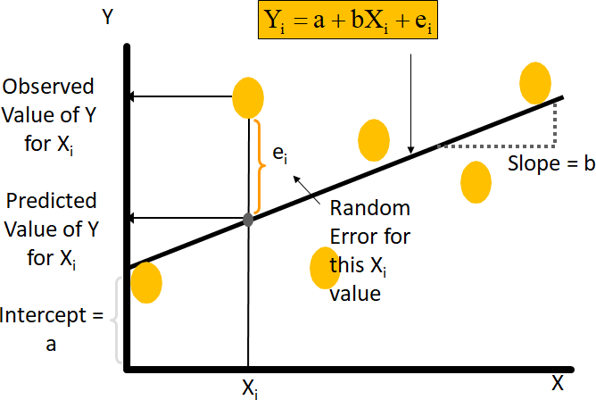
Simple Linear Regression Model

Slide 26
Now lets consider a Television Production House example (data set 2)
In order to understand the Television Production house dataset, we will take a sample of 38 observations as shown in the table.
Dependent variable (y): Advertising Revenue
Independent variable (x): Promotion
In the Television Production House example , we believe:
𝐴𝑑𝑣𝑒𝑟𝑡𝑖𝑠𝑖𝑛𝑔 𝑅𝑒𝑣𝑒𝑛𝑢𝑒 = 𝑎 + 𝑏_{𝑖} ∗ 𝑃𝑟𝑜𝑚𝑜𝑡𝑖𝑜𝑛 + 𝑒_{𝑖}
Now we need to estimate what the coefficients values are, from the data available, that will best capture
the relationship between Advertising Revenue and Promotion.

Slide 27
Ordinary Least Square
In statistics, ordinary least squares (OLS) is a method for estimating the unknown parameters in a linear regression model, with the goal of minimizing the sum of the squares of the differences between the observed values and predicted values which are calculated by a linear function of a set of independent variable.
Graph of Revenue and Promotion
1600000
1400000
1200000
1000000
800000
600000
400000
200000
0
0
50000
100000
150000
200000
250000

Slide 28
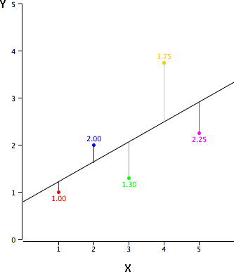
Best Fit Line
Consider a Scatter plot in the above slide, if we assume a straight line relationship is present between the variables, then draw a straight line that best captures the relationship between Promotion and Revenue.
From scatter plot we can clearly say that there are many lines that will cover some of the points
To know the best fit line refer the below explanation.
How many lines are possible to capture the relationship?
Many lines are possible to capture the relationship.
Which is the best possible straight line?
The black diagonal line is the regression line and consists of the predicted score on Y for each possible value of X. The vertical lines from the points to the regression line represent the errors of prediction.
As you can see, the red point is very near the regression line; its error of prediction is small. By contrast, the yellow point is much higher than the regression line and therefore its error of prediction is large.
The best-fitting line is the line that minimizes the sum of the squared
errors of prediction.

Slide 29

Ordinary least square
The ordinary least square regression used for estimating line that minimizes the sum of the squares of the errors
Why Square of error?
It magnifies or penalizes, the larger errors.
It cancels the effect of the positive and negative values
Mathematically, minimize

Slide 30


Least Square Regression
Using differential calculus, we will get
These estimates are called the Least Squares estimates
The Least Squares estimate line minimizes errors more than any other line.

Slide 31
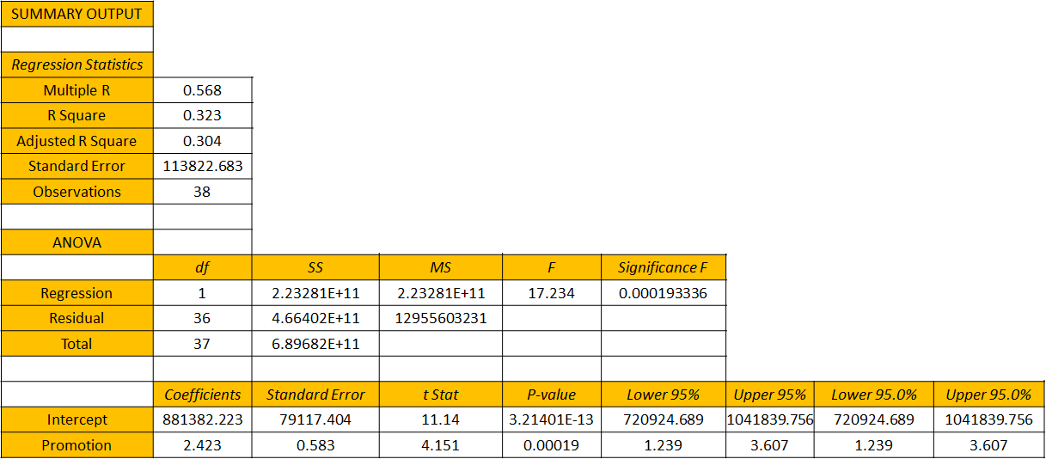
Output of Simple Linear Regression

Slide 32
Output Interpretation
You can see that there are three distinct tables in the output
Regression Statistics Table
ANOVA Table
Coefficient Table

Slide 33
Coefficients Table
In the below coefficients table, the model that has been generated on the data that best possible straight line is actually this line.
Advertising Revenue = 881382.223 + 2.423* Promotion
In our straight line equation, the slope is 2.423 and intercept is 881382.223.
The intercept of 881382.223 explains that with zero promotion cost we expect the advertising revenue is
positive.
With the slope of 2.423 explains that 1 unit increase in promotion cost increases advertising cost by 2.423 but the reverse is not true means the 2.423 increase in advertising cost doesn’t explain that promotion cost is increased by 1 unit due to cause and effect relationship.
The straight line consist with above intercept and slope is best fitted line.
Advertising Revenue = 881382.223 + 2.423* Promotion

Slide 34
What is the Advertising Revenue?
What is the advertising revenue if the promotion cost is 1,40,000?
Advertising Revenue = 881382.223 + 2.423∗ Promotion = 881382.223+2.423∗ 1,40,000 = 12,20,602.223

Slide 35
Hypothesis test & P value
We conduct a hypothesis test to determine whether there is a significant linear relationship between an independent variable X and a dependent variable Y.
Y = a +bx
If we find that the slope of the regression line is significantly different from zero, we will conclude that
there is a significant relationship between the independent and dependent variables. (b ≠ 0)
State the Hypotheses
If there is a significant linear relationship between the independent variable X and the dependent
variable Y, the slope will not equal zero
Ho: A statistically significant relationship doesn’t exists between the two variable. (B = 0)
Ha: A statistically significant relationship exists between the two variable. (B ≠ 0)
In our Example, P value is 0.00019 which is less than 0.05
Hence, We can reject the null hypothesis and say that slope (b) is not equal to 0 means “a statistically
significant relationship exists between promotion and revenue”.

Slide 36
Standard Error
"Standard error" gives the standard errors (i.e. the estimated standard deviation) of the least squares estimates b_{j} of β
Y variable is a random variable which is influenced by factors that are outside of anyone’s control.
There will always be some variation in Y that cannot be explained. It’s because of random variation.
In our example standard error is 0.583

Slide 37
Confidence Interval
In statistics, a confidence interval (CI) is a type of interval estimate(of a population parameter) that is computed from the observed data.
The confidence level is the frequency (i.e., the proportion) of possible confidence intervals that contain
the true value of their corresponding parameter.
Smaller the standard error narrower the confidence interval
With 95% confidence interval, when x increases by 1 unit doesn’t mean that y will always increase by
2.423 it may increase more or less than 2.423.
In our example 1, We can say that when x increases by 1 unit 95% times y will decrease to 1.239 and
increase to 3.607.
So we know 95% of the time this values show how much Y will increase by.

Slide 38
Coefficient of Determination – R2
The coefficient of determination (denoted by R2) is a key output of regression analysis. It is interpreted as the proportion of the variance in the dependent variable that is predictable from the independent variable. (Goodness of fit)
Coefficient of determination is used in trend analysis & computed as a value between 0 and 1
Our aim is to find out the best possible straight line that explains of captures the relationship between X
and Y.
The higher the value of R Square the more variation in Y and therefore the model is good.
It is a good measure of variation but it is only one measure of model fit.
_{R2 =} SSR ₌ regression sum of squares
SST total sum of squares

Slide 39



Coefficient of Determination – R2
Y
R² = 1
X
Perfect linear relationship
between x and y:
R² = 1
Y
100% of the variation in y is
explained by variation in x
X
R² = +1

Slide 40



Coefficient of Determination – R2
Y
0 < R² < 1
Weaker linear relationship between
x and y:
X
Some but not all of the variation in
y is explained by variation in x
Y
X

Slide 41
R-Square: Television Production House Example 2
32.37% of the variation in advertising revenue is explained by variation in promotion in money
𝑅² = ^{𝑆𝑆𝑅} = ^{2.23281𝐸 + 11} = 0.3237 = 32.37%
𝑆𝑆𝑇 6.89682𝐸 + 11

Slide 42
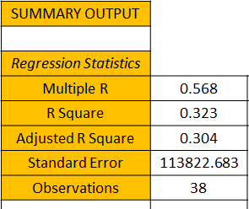
R-Square: Television Production House Example 2
In our example, The R Square is 32.37%
It means that 32.37% of the variation in advertising revenue is explained by variation in promotion
money

Slide 43
Adjusted 𝑹^{𝟐}
The adjusted R-squared is a modified version of R-squared that has been adjusted for the number of predictors in the model.
The adjusted R-squared increases only if the new term improves the model more than would be expected
by chance.
The adjusted R-squared compares the explanatory power of regression models that contain different
numbers of predictors.
It decreases when a predictor improves the model by less than expected by chance.
The adjusted R-squared can be negative, but it’s usually not.
It is always lower than the R-squared.
In our Example, the adjusted 𝑹^{𝟐} is 30.4%

Slide 44
Standard Error
The standard error of the mean is the standard deviation of the sampling distribution of the mean.
The magnitude of the standard error of the mean depends on both the variability of the observation(s)
and no of observations (n).
It is the standard deviation of a large number of sample means of the same sample size drawn from
sample population.
Standard error is used to estimate the variation in the set of means.
𝑠
𝑆𝐸 =
𝑛
Where,
s = Sample standard deviation
n= No. of observations in the sample

Slide 45

Standard Error
Standard error is a statistical term that measures the accuracy with which a sample represents a population.
In statistics, a sample mean deviates from the actual mean of a population; this deviation is the standard
error.
𝑆_{𝑒} = 113822.683

Slide 46
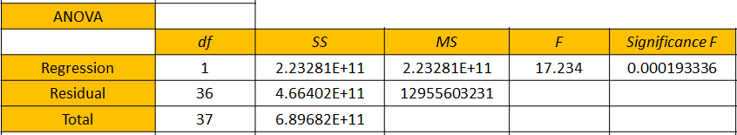
ANOVA Table
ANOVA and Regression have similar kind of model called as generalized linear model.
F test is used to test the significance in regression
With only one independent variable f test will provide same conclusion as t test
If t test indicates b≠ 0 and hence a significance relationship, the f test will also indicate a significant relationship.
With more number of independent variable only F test is used for overall significant relationship.

Slide 47
Multiple Linear Regression

Slide 48
Multiple Linear Regression
Let’s continue our example 1 (Simple linear regression), the television production house decided to predict revenue by considering only one factor i.e. promotion to predict revenue by considering only one factor i.e. promotion to find out the advertising revenue.
Now they decide to add other factors i.e. television rating point (TRP), Promotion, Language of Program to
predict the revenue.
Here, the dependent and independent variables are
X= Television rating point(TRP), Promotion, Language of program.
Y= Advertising Revenue
So, this is the form of Multiple linear regression

Slide 49
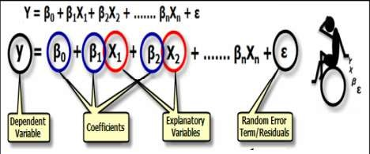
Multiple Regression
Multiple regression is the most common form of linear regression analysis.
The multiple linear regression is used to explain the relationship between one dependent and two or more independent variables.
The independent variables can be continuous or categorical.
The multiple linear regression fits a line through a multi-dimensional space of data points.
There are 3 major uses for multiple linear regression analysis are as follows.
To identify the strength of the effect that the independent variables have on a dependent variable.
To forecast effects or impacts of changes.
It predicts trends and future values.
It is used to get point estimates.
An important consideration for selecting a model is model fit.
Addition of an independent variables to a model will increase the amount of explained variance in the
dependent variable (i.e. R²).
Addition of many independent variables without any theoretical justification may result in an over-fit
model.

Slide 50
Multiple Linear Regression Example
In our current example, the dependent and independent variables are,
X = Television rating point (TRP), Promotion, Language of program.
Y = Advertising Revenue
Let’s see how to calculate the advertising revenue based on other factors using Excel in Multiple
linear regression
The Multiple linear regression equation is
𝑌 = 𝑎 + 𝑏₁ ∗ 𝑇𝑒𝑙𝑒𝑣𝑖𝑠𝑖𝑜𝑛 𝑅𝑎𝑡𝑖𝑛𝑔 𝑃𝑜𝑖𝑛𝑡 + 𝑏₂ ∗ 𝑃𝑟𝑜𝑚𝑜𝑡𝑖𝑜𝑛 + 𝑏₃ ∗ 𝐿𝑎𝑛𝑔𝑢𝑎𝑔𝑒

Slide 51
How to Analyse a Linear Model
Step 1: Exploratory Data Analysis(EDA)
Univariate Analysis.
Analysing each variable for missing value treatment, Outlier treatment.
Bi-variate Analysis
Analysing each independent variable with the dependent variable to check the relationship between
the variables.
Step 2:Model Building.
Model Building involves checking the multi-collinearity and forming an linear regression equation.
Step 3: Checking the Assumptions.
There are principal assumptions which justify the use of linear regression models for purposes of inference or prediction which is one of the most important step before validation
Step 4: Model Validation
The validation process can involve analyzing the goodness of fit of the regression, analyzing whether the regression residuals are random, and checking whether the model's predictive performance deteriorates substantially when applied to data that were not used in model estimation.

Slide 52
Assumptions for Linear Regression
Assumption 1 : There must be a linear relationship between the outcome variable and the independent
variables
How to Check it: Scatterplots can show whether there is a linear or curvilinear relationship or no
relationship between the variables.
Assumption 2: There must be no Linear relationship between the Residuals and the independent
variables or between the residuals and the fitted value(Predicted variable)
How to Check it: Scatterplot can be drawn considering Residuals as Y variable and independent variables as X variables or Residuals as Y variables and Fitted values as X variables respectively.
Assumption 3 : Multicollinearity means that some of the Independent variables are highly correlated with each other.
How to check it: Calculating the Variance inflation factor.
Assumption 4: Homoscedasticity must be present as it describes a situation in which the error term in the relationship between the independent and the dependent variable is same across all values of the independent variables.
How to Check: Using a scatter plot for residuals
We will learn about assumptions in detail in the up coming slides.

Slide 53
Dataset 3
Serial | TRP | Promotion | Language | Revenue
1 | 133 | 111600 | 1 | 1197576
2 | 111 | 104400 | 0 | 1053648
3 | 129 | 97200 | 1 | 1124172
4 | 117 | 79200 | 1 | 987144
5 | 130 | 126000 | 1 | 1283616
6 | 154 | 108000 | 1 | 1295100
7 | 149 | 147600 | 0 | 1407444
8 | 90 | 104400 | 0 | 922416
9 | 118 | 169200 | 0 | 1272012
10 | 131 | 75600 | 0 | 1064856
11 | 141 | 133200 | 0 | 1269960
12 | 119 | 133200 | 1 | 1064760
13 | 115 | 176400 | 0 | 1207488
14 | 102 | 180000 | 0 | 1186284
15 | 129 | 133200 | 0 | 1231464
16 | 144 | 147600 | 1 | 1296708
17 | 153 | 122400 | 1 | 1320648
18 | 96 | 158400 | 0 | 1102704
19 | 104 | 165600 | 1 | 1184316
20 | 156 | 104400 | 1 | 1326360
21 | 119 | 136800 | 1 | 1162596
22 | 125 | 115200 | 1 | 1195116

Slide 54
Multiple Linear Regression Output
SUMMARY OUTPUT
Regression Statistics
Multiple R | 0.932725089
R Square | 0.869976091
Adjusted R Square | 0.858503393
Standard Error | 51356.65693
Observations | 38
ANOVA
 | df | SS | MS | F | Significance F
Regression | 3 | 6.00007E+11 | 2.00002E+11 | 75.83012324 | 3.86382E-15
Residual | 34 | 89675211173 | 2637506211
Total | 37 | 6.89682E+11
 | Coefficients | Standard Error | t Stat | P-value | Lower 95% | Upper 95% | Lower 95.0% | Upper 95.0%
Intercept | 13409.52169 | 81642.40721 | 0.164247015 | 0.870509245 | -152507.8121 | 179326.8555 | -152507.8121 | 179326.8555
TRP | 5841.424103 | 515.3816965 | 11.33417066 | 4.29687E-13 | 4794.04248 | 6888.805726 | 4794.04248 | 6888.805726
Promotion | 3.240654727 | 0.272586637 | 11.88853114 | 1.16478E-13 | 2.68669203 | 3.794617425 | 2.68669203 | 3.794617425
Language | 53211.02783 | 16871.23458 | 3.153949854 | 0.003359968 | 18924.554 | 87497.50167 | 18924.554 | 87497.50167

Slide 55
Coefficient Table
In coefficient table one thing we need to check is the sign of the coefficient and p value.
Y = 41060.006 + 5481.424* TRP +3.240*Promotion + 53211.027 * Language
The positive coefficients indicates that it have positive effect
The null and alternate hypothesis of our example is mentioned below:
Ho: A statistically significant relationship doesn’t exists between the two variable.
Ha: A statistically significant relationship exists between the two variable.
The p-value of all independent variables are less than significance level. Means we reject null
hypothesis. Hence all variables are significant.
 | Coefficients | Standard Error | t Stat | P-value | Lower 95% | Upper 95% | Lower 95.0% | Upper 95.0%
Intercept | 13409.52169 | 81642.40721 | 0.164247015 | 0.870509245 | -152507.8121 | 179326.8555 | -152507.8121 | 179326.8555
TRP | 5841.424103 | 515.3816965 | 11.33417066 | 4.29687E-13 | 4794.04248 | 6888.805726 | 4794.04248 | 6888.805726
Promotion | 3.240654727 | 0.272586637 | 11.88853114 | 1.16478E-13 | 2.68669203 | 3.794617425 | 2.68669203 | 3.794617425
Language | 53211.02783 | 16871.23458 | 3.153949854 | 0.003359968 | 18924.554 | 87497.50167 | 18924.554 | 87497.50167

Slide 56
Assumptions
Before we start on assumptions, lets understand the Residuals. Residuals are the difference between Predicted Values of Y and | Serial Number | Actual | Predicted | Residuals
 | 1 | 1197576 | 1205187.023 | -7611.02
the Actual Values of Y | 2 | 1053648 | 1053342.979 | 305.0215
 | 3 | 1124172 | 1081944.871 | 42227.13
 | 4 | 987144 | 953515.9962 | 33628
 | 5 | 1283616 | 1234328.179 | 49287.82
 | 6 | 1295100 | 1316190.572 | -21090.6
 | 7 | 1407444 | 1362102.351 | 45341.65
 | 8 | 922416 | 930673.0724 | -8257.07
 | 9 | 1272012 | 1251016.346 | 20995.65
 | 10 | 1064856 | 1023629.577 | 41226.42
 | 11 | 1269960 | 1268705.53 | 1254.47
 | 12 | 1064760 | 1140194.2 | -75434.2
 | 13 | 1207488 | 1256824.787 | -49336.8
 | 14 | 1186284 | 1192552.631 | -6268.63
 | 15 | 1231464 | 1251819.469 | -20355.5
 | 16 | 1296708 | 1386106.258 | -89398.3
 | 17 | 1320648 | 1357014.576 | -36366.6
 | 18 | 1102704 | 1087505.944 | 15198.06
 | 19 | 1184316 | 1210781.079 | -26465.1
 | 20 | 1326360 | 1316207.063 | 10152.94

Slide 57
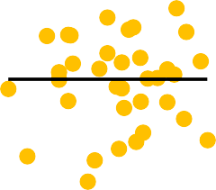
Assumptions
CHECKING IF ASSUMPTIONS AREVALID
1. Plot the residuals against Predicted values
Residuals = Observed value – Predicted value (Fitted Value)
For linear regression, the linear relationship should not be present between residuals and
predicted values.
If a relationship is present, it means that the predict values do not fit in the model.
It is important to check for outliers since linear regression is sensitive to outlier effect
This assumption is tested with scatter plot
Residuals
200000
150000
100000
50000
The Scatter plot clearly shows that there is no relationship between the residuals and the predicted variables.
0
-50000
-100000
-150000

Slide 58
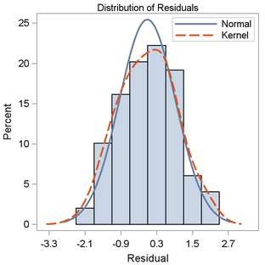
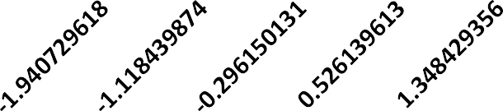
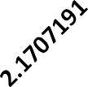
Assumption - Normality
MLR requires that the error between observed and predicted values (i.e., the residuals of
the regression) should be normally distributed. (ref the below distribution of residuals diagram)
This assumption can best be checked by plotting residual values on a histogram with a fitted normal
curve or by reviewing a Q-Q-Plot.
Normality can also be checked with a goodness of fit test e.g., the Kolmogorov-Smirnov test
When the data is not normally distributed, a non-linear transformation might correct this issue if one or
more of the individual predictor variables are to blame, though this does not directly respond to the
normality of the residuals.
Residuals
16
14
12
10
8
6
4
2
0
Our histogram shows that residuals in our model normally are distributed

Slide 59
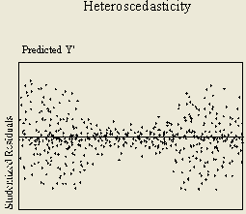
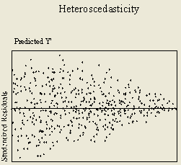
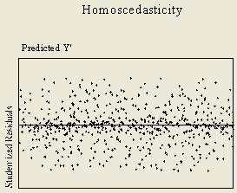
Assumption – Homoscedasticity and Heteroscedasticity
Homoscedasticity describes a situation in which the error term is normally distributed, there is no
such pattern in the in residuals as shown in the diagram 3.
Heteroscedasticity is describes a situation when the residuals follow a specific pattern as shown in
the diagram 1 and diagram 2.
For a model to be good fit, Homoscedasticity should be present(No specific pattern) and there should be no Heteroscedasticity(a specific data Pattern )

Slide 60





Assumption- Homoscedasticity and Heteroscedasticity
According to the assumptions, there must be no pattern in the standard residuals scatter plot but we can see a pattern in the scatter plot in our scatter plot. Which means, heteroscedasticity is present.
Standard Residuals
4
0 10 | 20 | 30 | 40
3
2
1
The solution to this problem is log transformation and we will learn more about the log transformation in the next case study done on R.
0
-1
-2
-3

Slide 61
Assumption – Multi-collinearity
Multiple linear regression analysis requires that there is little or no multi-collinearity in the
independent variables.
Multicollinearity generally occurs when there are high correlations between two or more predicted variables.
In other words, one predictor variable can be used to predict the other. This creates a false
information, skewing the results in a regression model.
Examples of correlated predictor variables (also called multicollinear predictors) are: a person’s height
and weight, age and sales price of a car, or years of education and annual income.
Cook's distance is a commonly used estimate of the influence of a data point when performing a least-
squares regression analysis

Slide 62
Model Validation

Slide 63
Regression Results : Model Fit
Validate the model
R²
Adjusted R²
Fit Chart - Actual vs Fitted Values
MAPE – Mean Absolute Percentage Error
RMSE – Root Mean Square Value

Slide 64
R Square
R-squared supposes that every independent variable in the model
explains the variation in the dependent variable.
It gives the percentage of explained variation as if all independent
variables in the model affect the dependent variable
The drawback of using Coefficient of determination is that the value of the coefficient of determination always increases as the number of independent variables are increased even if the marginal contribution of the incoming variable is statistically
insignificant.
To take care of the above drawback, coefficient of determination is adjusted for the number of independent variables taken. This adjusted measure of coefficient of determination is called adjusted
_{R}2
Lets continue example 1, The value of R square is 86.99%
Regression Statistics
Multiple R | 0.932725089
R Square | 0.869976091
Adjusted R Square | 0.858503393
Standard Error | 51356.65693
Observations | 38

Slide 65
Adjusted R Square
The adjusted R-squared gives the percentage of variation explained by
only those independent variables that in reality affect the dependent
variable.
The adjusted R-squared compensates for the addition of variables and only increases if the new term enhances the model above what would be obtained by probability and decreases when a predictor enhances the
model less than what is predicted by chance.
In an overfitting condition, an incorrectly high value of R-squared, which leads to a decreased ability to predict, is obtained. This is not the case with the adjusted R-squared.
Lets continue example 1, The value of adjusted R square is 85.85%
Adjusted R² is given by the following formula:
Regression Statistics
Multiple R | 0.932725089
R Square | 0.869976091
Adjusted R Square | 0.858503393
Standard Error | 51356.65693
Observations | 38
⎡ n −1
× (1− R )
⎤
2
⎛ ⎞
2
R = 1−
⎥
a
⎢⎜ n − k −1⎟
⎣⎝
⎠
⎦
where
N = Number of Observations
k = Number of Independent Variables
= Adjusted R²

Slide 66
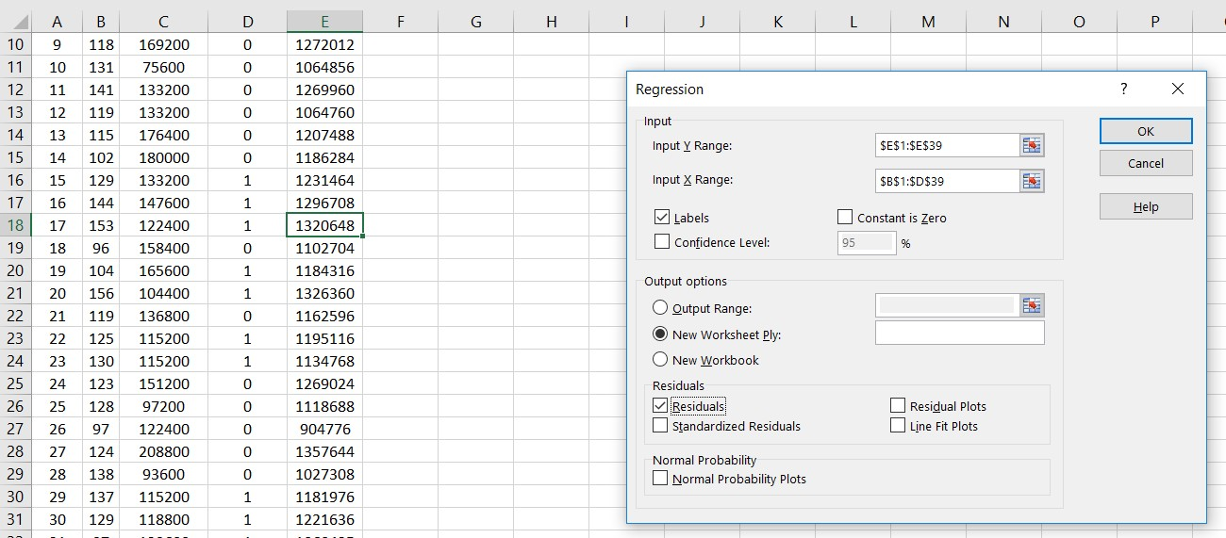
Actual vs Fitted Values
Fitted Values means we fit a x value in a straight line equation and finding the value of Y.
Fitted values are values of the Dependent variable (Advertising Revenue) according to the model.
We can automatically generate the fitted values in Excel, using the actual data values for the X variable
values:
Y = 13409.52 + 5841.42 ∗ 𝑇𝑒𝑙𝑒𝑣𝑖𝑠𝑖𝑜𝑛 𝑅𝑎𝑡𝑖𝑛𝑔 𝑃𝑜𝑖𝑛𝑡 + 3.24 ∗ 𝑃𝑟𝑜𝑚𝑜𝑡𝑖𝑜𝑛 + 53211.02 ∗ 𝐿𝑎𝑛𝑔𝑢𝑎𝑔𝑒

Slide 67
Actual vs Fitted Values
Fitted value is used to validate a model
In a good model, the difference between actual and predicted is very
less and are close to each other
A good model have higher number of overlap
Fitted Chart
Actual Revenue | Predicted Revenue
1197576 | 1205187.023
1053648 | 1053342.979
1124172 | 1081944.871
987144 | 953515.9962
1283616 | 1234328.179
1295100 | 1316190.572
1407444 | 1362102.351
922416 | 930673.0724
1272012 | 1251016.346
1600000
1400000
1200000
1000000
800000
600000
400000
200000
0
1 2 3 4 5 6 7 8 9 1011121314151617181920212223242526272829303132333435363738
Actual Revenue Predicted Revenue

Slide 68
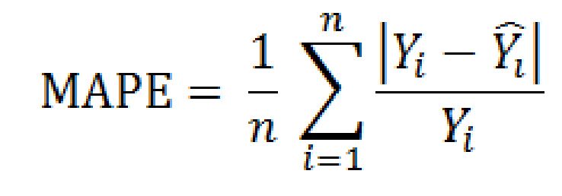
MAPE – Mean Absolute Percentage Error
The mean absolute percentage error (MAPE), also known as mean absolute percentage Deviation (MAPD).
MAPE is a measure of prediction accuracy of a forecasting method in statistic.
It has major Drawback in practical application

Slide 69
MAPE Example
Lets continue example 1 to find out the MAPE.
In our example mean absolute percentage error is 3%
Ideally MAPE values are low i.e. 5% or lower.
 | Actual Advertising Revenue | Predicted Advertising Revenue | Residuals | Absolute Residuals | Abs value of error/ actual value
Serial Number | Actual | Predicted | Actual – Predicted | Absolute of Residuals
1 | 1197576 | 1205187 | -7611.02 | 7611.023 | 0.006355
2 | 1053648 | 1053343 | 305.0215 | 305.0215 | 0.000289 | MAPE | 3%
3 | 1124172 | 1081945 | 42227.13 | 42227.13 | 0.037563
4 | 987144 | 953516 | 33628 | 33628 | 0.034066
5 | 1283616 | 1234328 | 49287.82 | 49287.82 | 0.038398
6 | 1295100 | 1316191 | -21090.6 | 21090.57 | 0.016285
7 | 1407444 | 1362102 | 45341.65 | 45341.65 | 0.032216
8 | 922416 | 930673.1 | -8257.07 | 8257.072 | 0.008952
9 | 1272012 | 1251016 | 20995.65 | 20995.65 | 0.016506
10 | 1064856 | 1023630 | 41226.42 | 41226.42 | 0.038715
…… | …… | …… | …… | …… | ……
37 | 1338060 | 1332763 | 5296.699 | 5296.699 | 0.003958
38 | 1457400 | 1310052 | 147347.7 | 147347.7 | 0.101103
Total |  |  |  |  | 1.183679

